Slide 1

Reserve Tab

Slide 2

Project members
Md. Fahim Abrar 180042101
Md. Adnan Rahman Robe 180042108
Md. Wasif Kader 180042138

Slide 3
Contribution:
Database design : Wasif
UI design : Fahim, Robi
Admin dashboard: Robi,Wasif
Login module: Fahim, Robi
Reservation module: Wasif

Slide 4
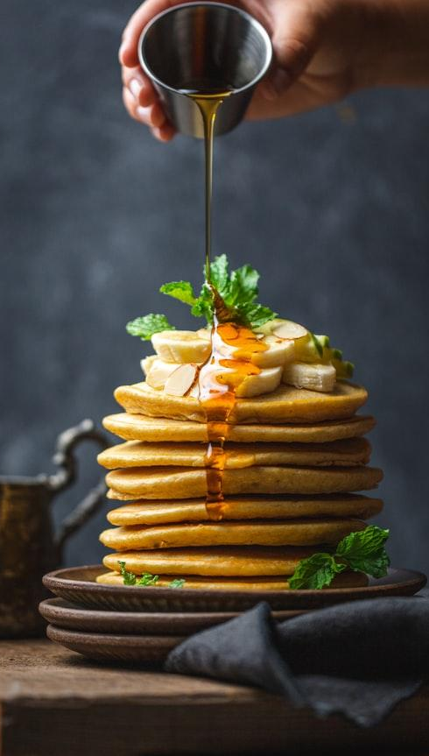
Motivation
ReserveTab is going to be used for reserving your seat in your favourite restaurant with some other additional features .You don’t have to worry about being there physically nor do you have to call someone and ask different questions which is a bit time consuming and frustrating sometimes.

Slide 5
What can our website do?
1
You can see the menu and then the website can help you reserve a table very easily.You can give us feedback of your experience while using our website and also added google maps for the ease of finding the restaurant.

Slide 6
Features
The upcoming Slides will give you an idea about the features we implemented in our website.

Slide 7
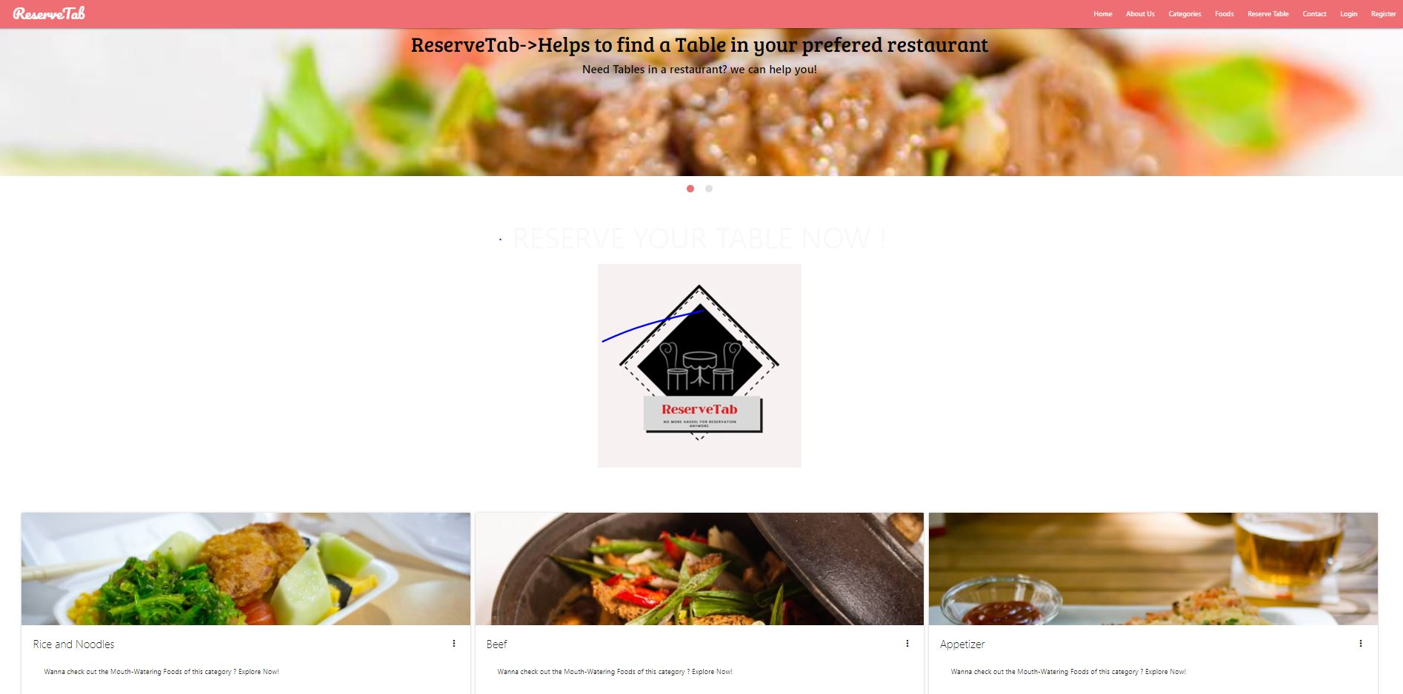
Landing page
This is the landing page for our customers.

Slide 8
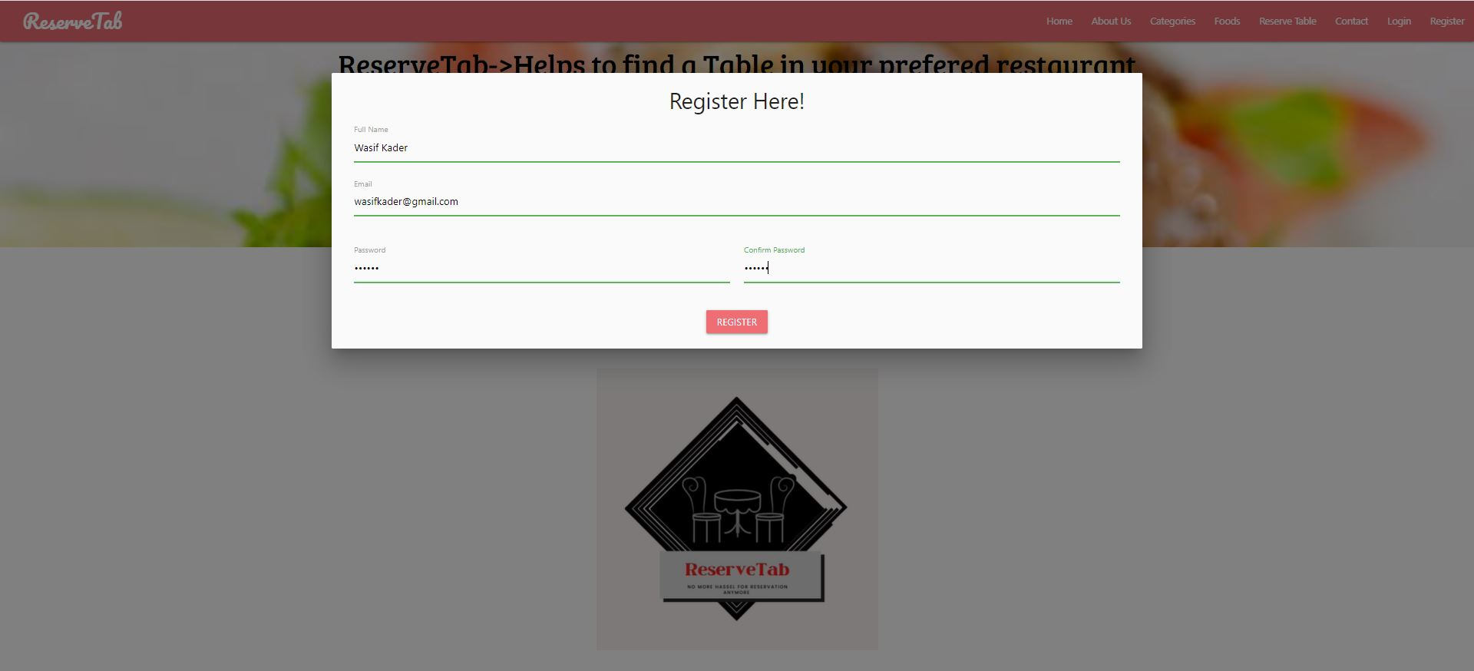
Registration and login
Our customers need to register first from the navbar and then he can log into the system

Slide 9
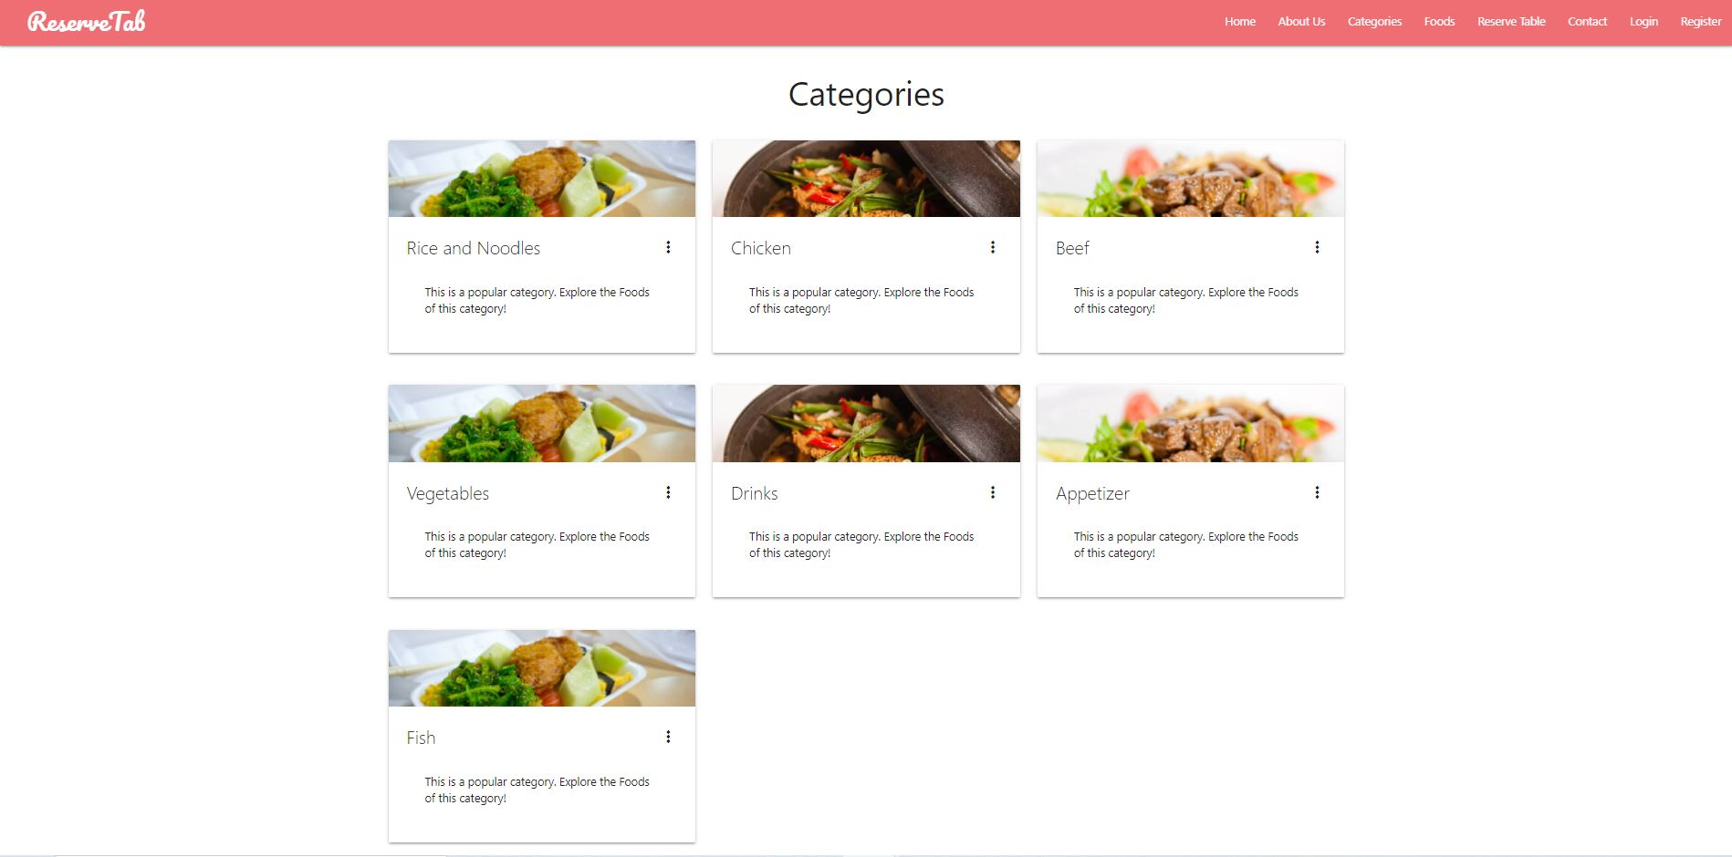
Our customers can view the categories and detailed food items.
Categories

Slide 10
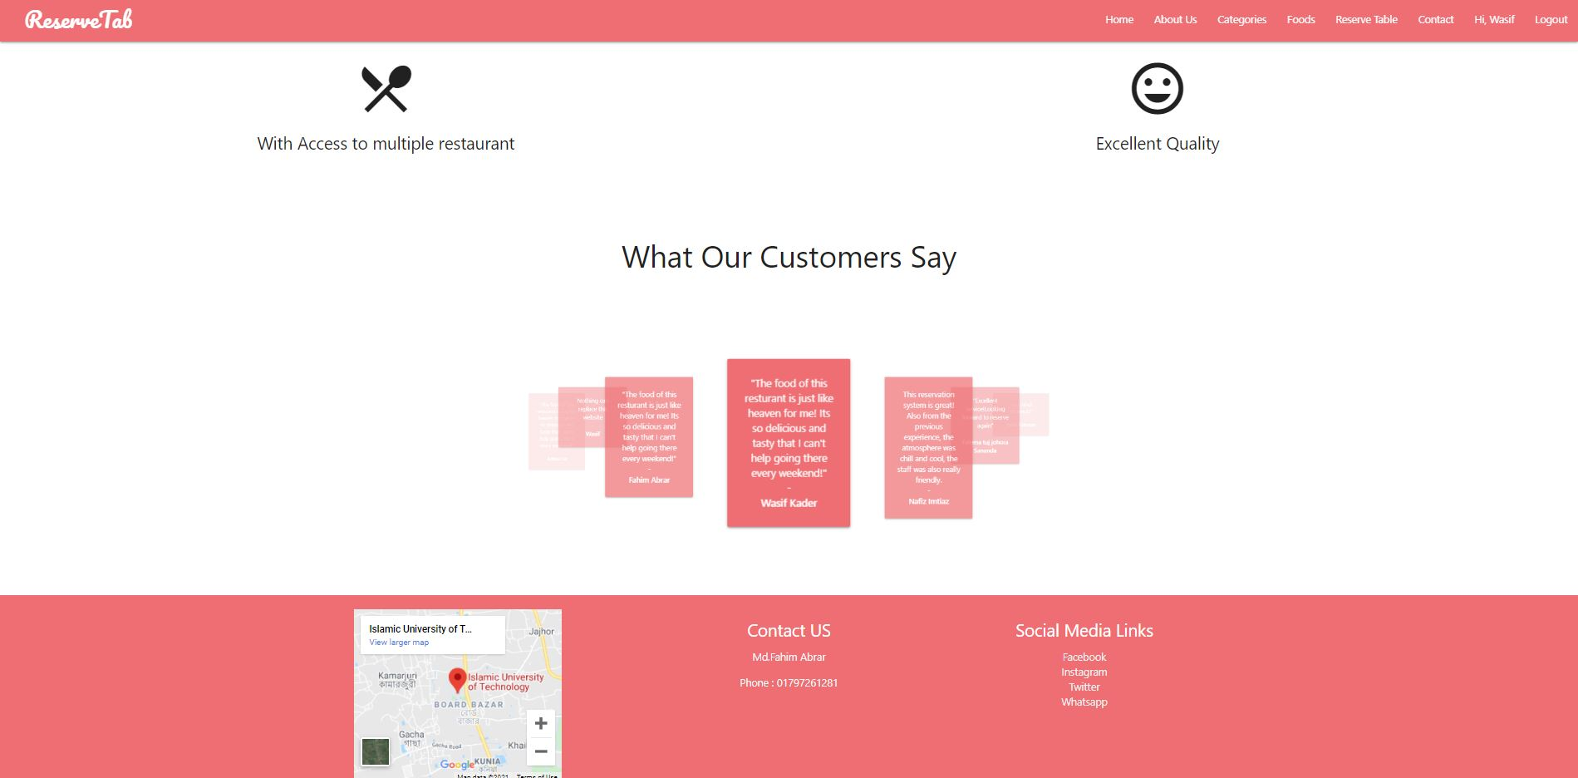
Our customers can view the previous reviews.
Reviews

Slide 11
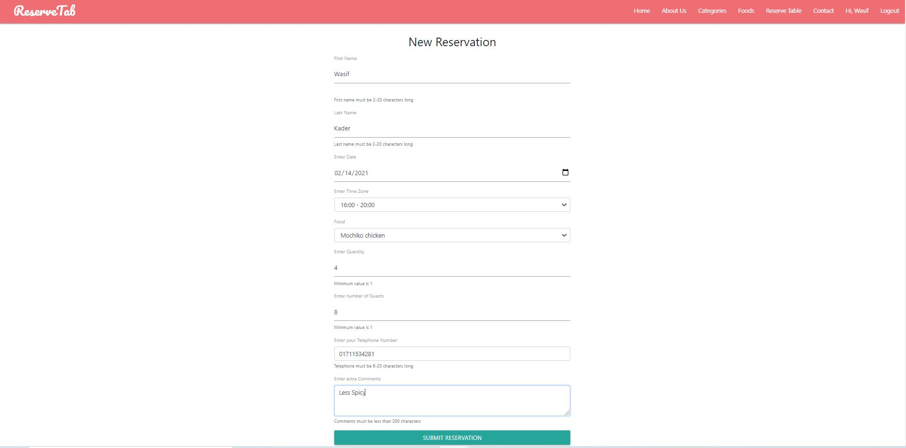
Our customers can reserve tables and give feedback.
Reservation

Slide 12
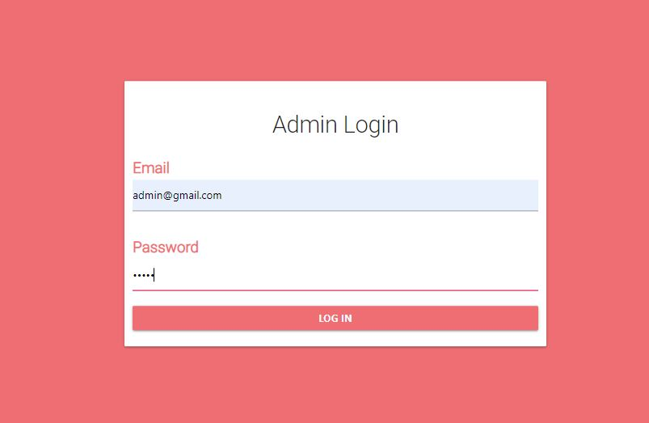
Admin features
Admin needs to log in to perform actions.

Slide 13
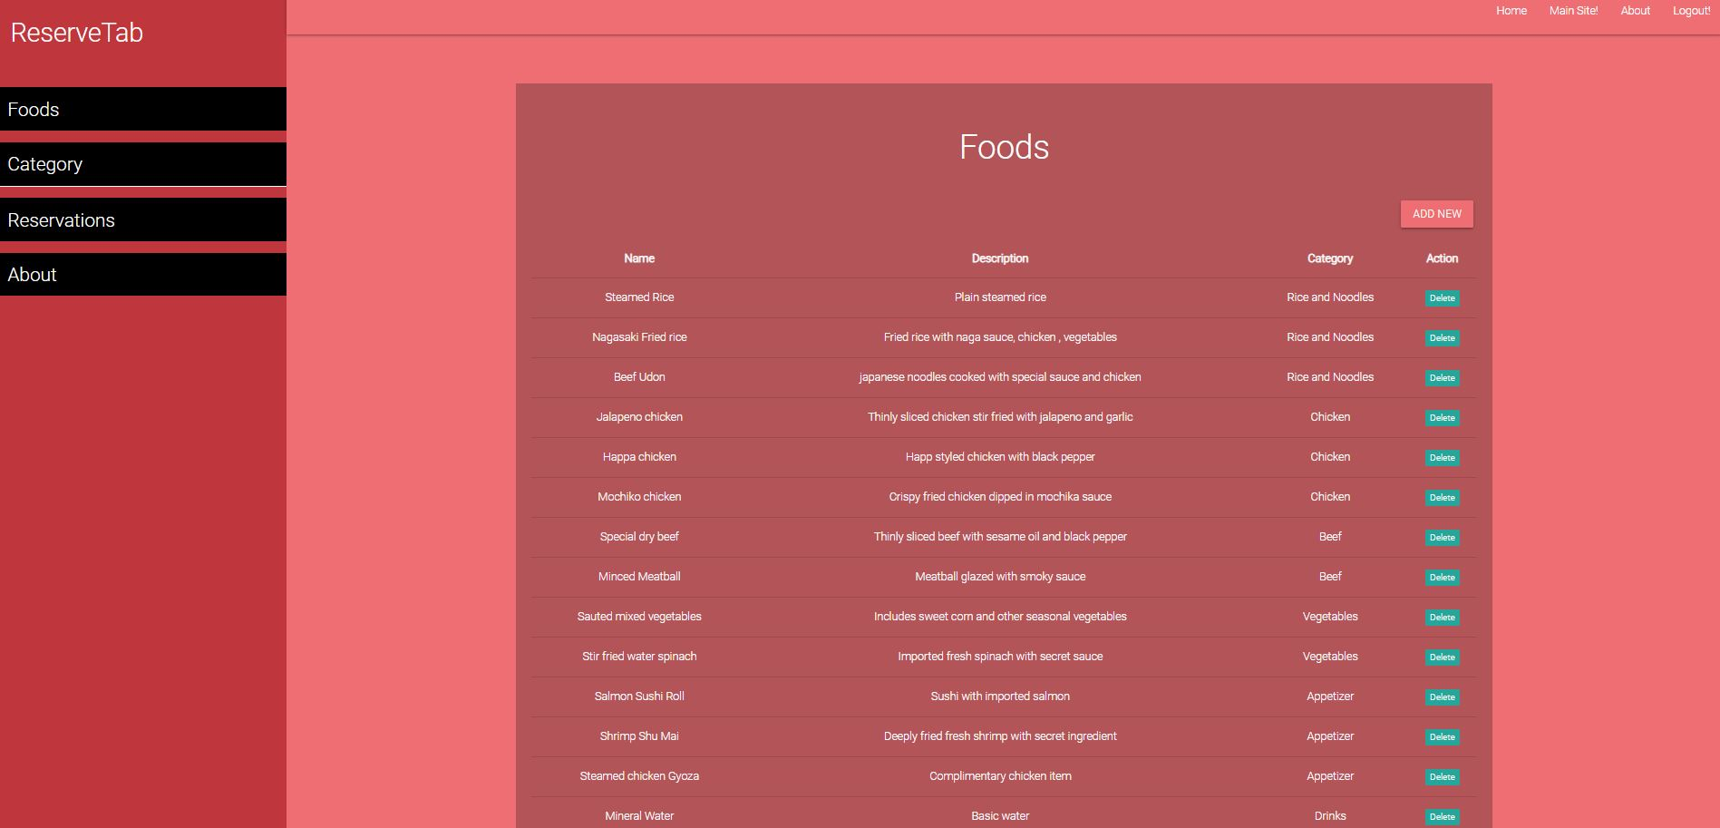
Admin features
Admin can view previously added food categories and food items

Slide 14
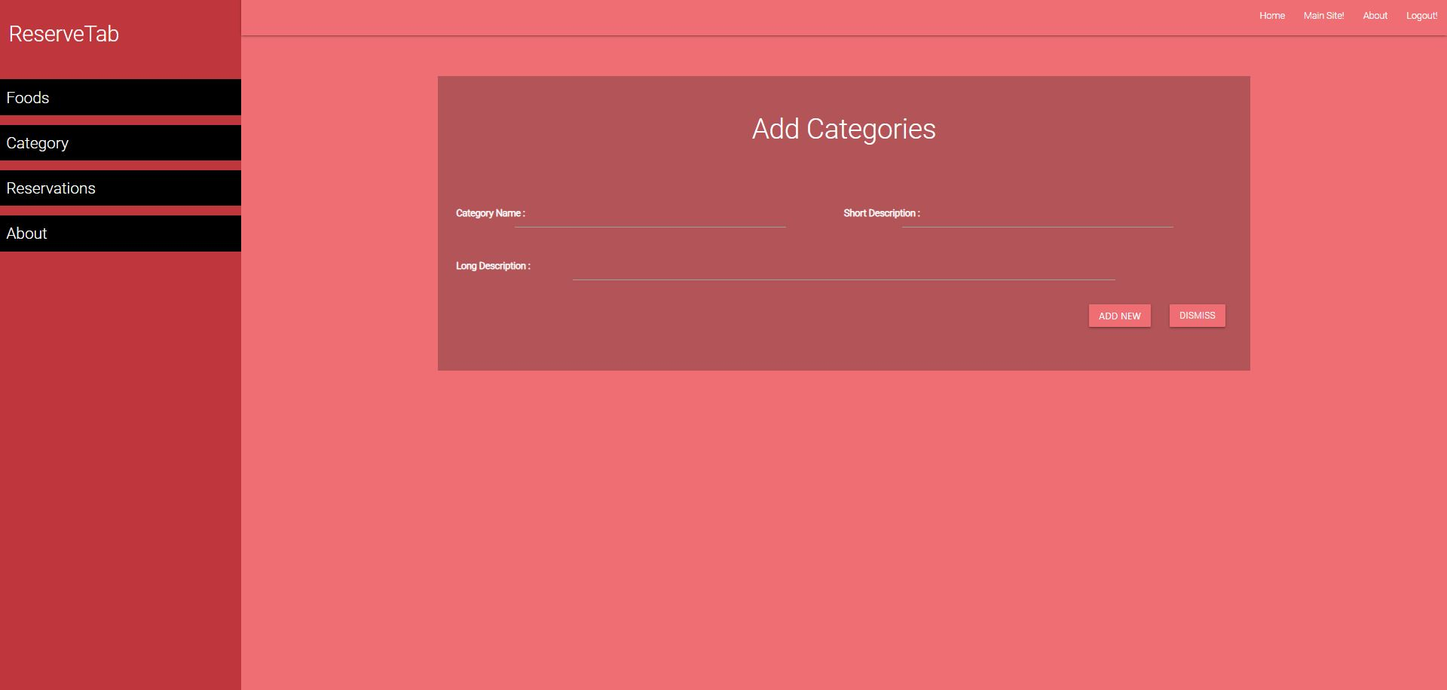
Admin features
Admin can also add and delete food categories and food items

Slide 15
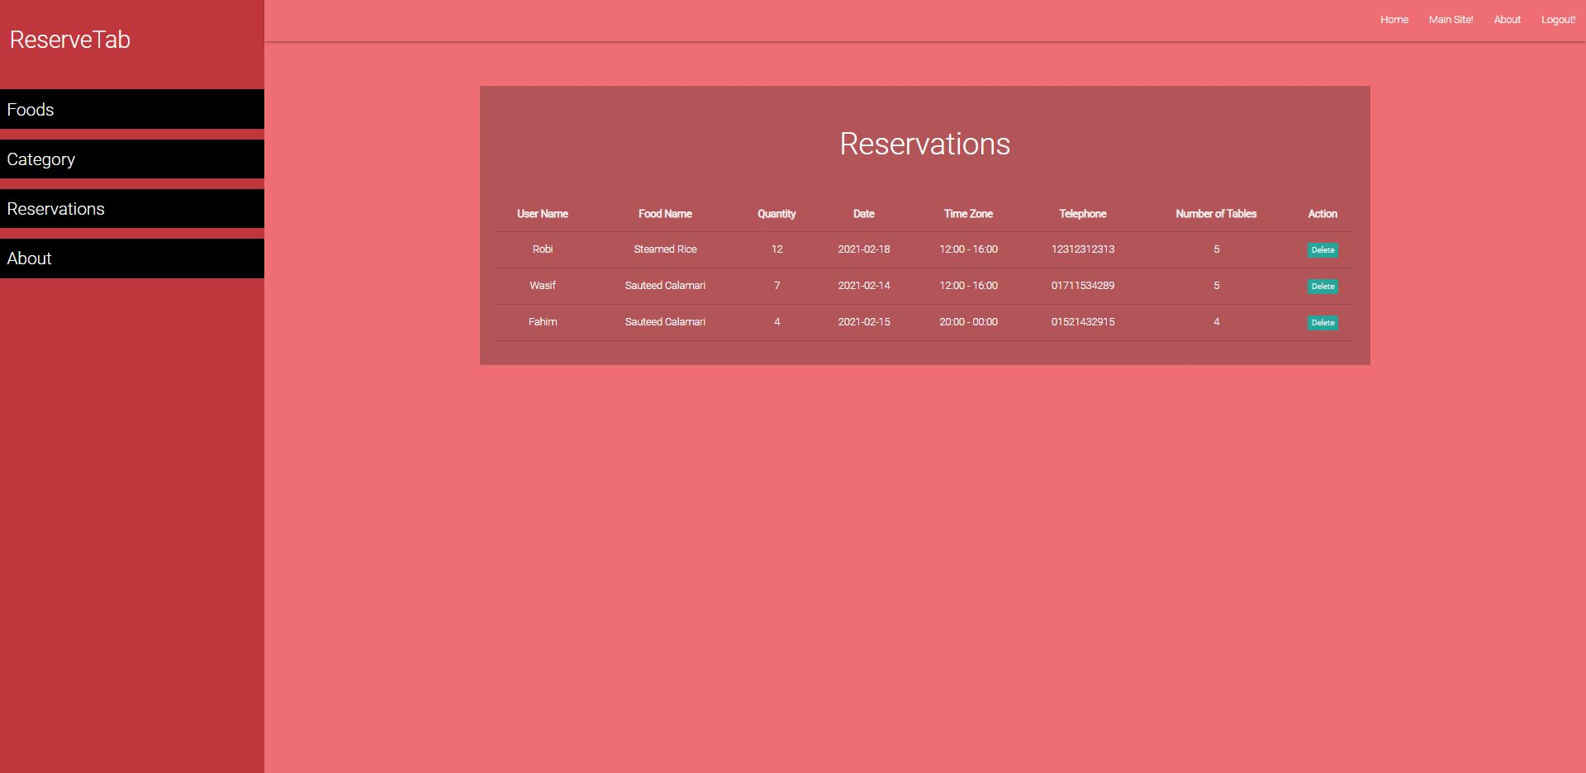
Admin features
Admin can view reservation info.

Slide 16

Timeline
Week 1-3 | Week 4-7 | Week 8-10 | Week 11-13
Registration, login and reservation for user
 | Add Foods, Categories , About us and some other features
 |  | Database designing,module implementation
 |  |  | Testing and other additional features.

Slide 17
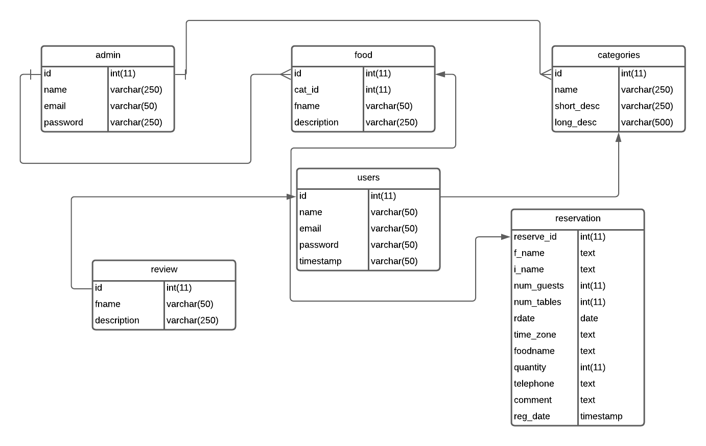
ERD:

Slide 18

Technologies
This System is built with HTML5, CSS, PHP, JavaScript and the database is in Mysql.

Slide 19

Highlights
No more wasting your valuable time
Choose the menu and enjoy your time.
Just a few steps from reserving your table.

Slide 20

Demo for the User Section:

Slide 21
Demo for the Admin Section:

Slide 22

Thank you
Thank you for your precious time and now we invite you guys to ask questions.

